Slide 1
R. Kurach, P. Kuśmierczyk, D. Papla
How useful is life-cycle approach for pension assets management?
presented by
Radosław Kurach
Wrocław University of Economics, Poland
Poznań, 20.09.2019

Slide 2
The outline
Motivation
The model
The results
Conclusions
How useful is life-cycle approach for pension assets management

Slide 3
1. Motivation – project’s research output
Project: Mandatory pension funds efficiency - lessons for Poland, National Science Centre UMO-2013/11/D/HS4/038407
Kurach, R., & Papla, D. (2016). Should pension funds hedge currency risk? The case of Poland. Baltic Journal of Economics, 16(2), pp. 81-94.
Greater allocation into foreign assets denominated in reserve currencies.
Kurach, R., Kuśmierczyk, P. & Papla, D. (2019). The optimal portfolio for the two pillar mandatory pension system: the case of Poland. Applied Economics, 51(23), pp. 2552-2565.
Significant risk reduction potential of life-cycle approach.
How useful is life-cycle approach for pension assets management

Slide 4
1. Motivation
Research question:
What if the life-cycle approach is banned?
How usefull is(was) safety-slider mechanism?
How useful is life-cycle approach for pension assets management

Slide 5
2. The model – general assumptions
We asume two assets unverse: social security records (NDC) and local equities
We assume nonnegative porfolio weights – no other constraints
The targeted wealth is expressed in terms of the replacement rate relative to the last salary (40-45%)
The income profile during the working life has been based on Kolasa (2012) estimates. Working life durations is 35 yrs. and the life expetancy during retirement is 20 yrs.
The overall pensions contribution is 19,52% of the gross salary and is paid once a year.
How useful is life-cycle approach for pension assets management

Slide 6
2. The model – assumptions on soc. security and equity returns
The forecasted returns consist of deterministic (trend) and stochastic (volatility) component ;
The returns on social security records guarantee that social security is actuarially balanced. Therefore our rate of return in every period is equal to the real wage bill growth in the economy;
We estimate the trend of a real wage bill growth as a product of the forecasted labour productivity growth and employment for Poland for the years 2015-2060 (European Comission, 2015);
How useful is life-cycle approach for pension assets management

Slide 7
3. The model – assumptions on soc. security and equity returns
The volatility component of social security is based on historical volatility of Polish GDP growth rate for the years 1995-2015;
The interdependence between the volatility component of ZUS returns and the volatility component of equity returns has been based on the estimates provided by (Żuk P. , 2013).
The trend component of equity returns is equal to social security trend + risk premium (3%)
The volatility component of equity returns based on historical volatility of Polish market
How useful is life-cycle approach for pension assets management

Slide 8
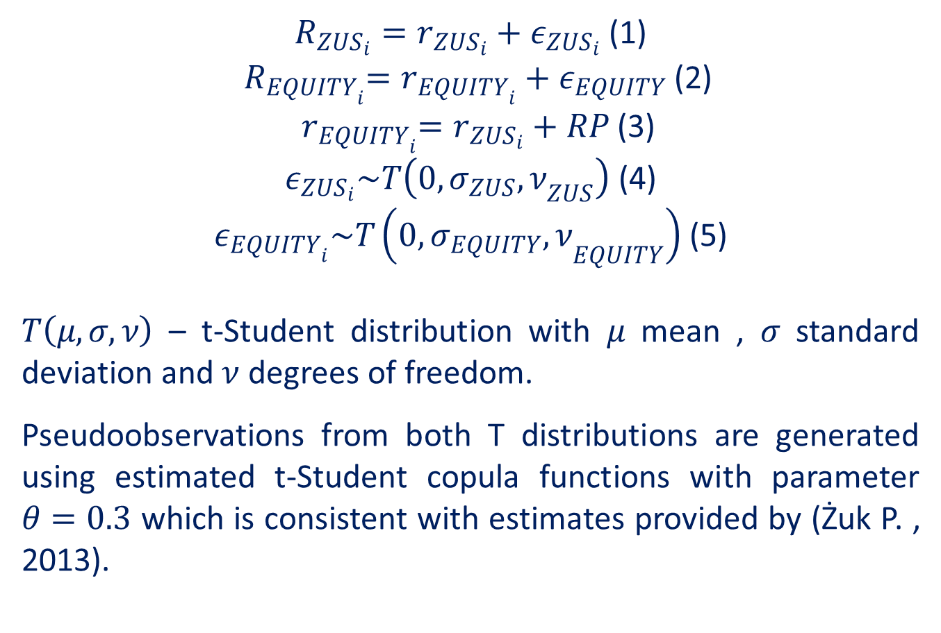
2. The model – assumptions on soc. security and equity returns
$R_{{ZUS}_{i}}=r_{{ZUS}_{i}}+ε_{{ZUS}_{i}}$ (1)
${ R}_{{EQUITY}_{i}}=r_{{EQUITY}_{i}}+ε_{EQUITY}$ (2)
${ r}_{{EQUITY}_{i}}=r_{{ZUS}_{i}}+RP$ (3)
$ε_{{ZUS}_{i}}\sim T\left(0,{σ_{ZUS},ν}_{ZUS}\right)$ (4)
$ε_{{EQUITY}_{i}}\sim T\left(0,{σ_{EQUITY},ν}_{EQUITY}\right)$ (5)
$T\left(μ,σ,ν\right)$ – t-Student distribution with $μ$ mean , $σ$ standard deviation and $ν$ degrees of freedom.
Pseudoobservations from both T distributions are generated using estimated t-Student copula functions with parameter $θ=0.3$ which is consistent with estimates provided by (Żuk P. , 2013).
How useful is life-cycle approach for pension assets management

Slide 9
4. The results
How useful is life-cycle approach for pension assets management

Slide 10
4. Conclusions
Safety slider is not a game changer;
Life-cycle approach offers significant risk reduction potential only if it is employed during the whole accumulation period.
How useful is life-cycle approach for pension assets management

Slide 11
Thank you for your attention!
radoslaw.kurach@ue.wroc.pl
How useful is life-cycle approach for pension assets management

