Slide 1

On retirement age once again
Maciej Żukowski
6th International Conference
Social Security Systems…
Poznań University of Technology, 19 September 2019

Slide 2

Why this topic?
A lot has been written on retirement age already.
In Poland this topic has become one of the main issues in political debate in recent years.
Recent statements and new developments have encouraged the author to raise the topic once again.

Slide 3
Contents
Concept of retirement age
Debates and legal changes in the retirement age
in Poland 2011-2019
3. Recent developments in pensions and on the labour market in Poland 2017-2019
4. Why and how to adjust retirement age to longer life?

Slide 4
1. Concept of retirement age
Retirement/ pension/ pensionable age
Minimum retirement age
Normal (standard) retirement age…
Here: the lowest (legal) age, at which drawing (full) retirement pension is possible
Possibility does not mean obligation.

Slide 5


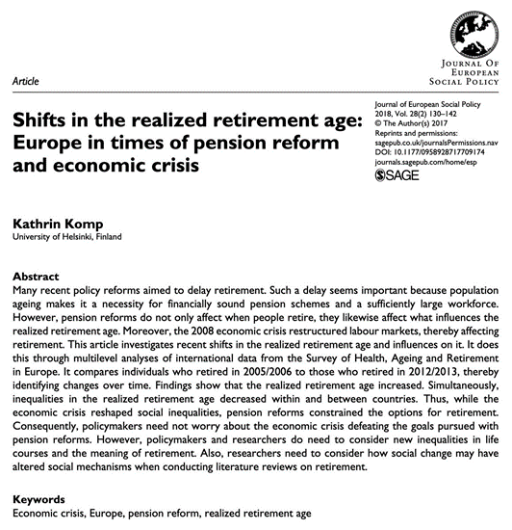
Retirement age in economic literature

Slide 6
2. Debates and legal changes in the retirement age in Poland 2011-2019
Short history
1927, 1933: 65
1954: 65 for men/ 60 for women (and 5 years lower for many categories)
Many early retirement possibilities
Reform project 1999: 62 for men and women
Failed attempts to increase the retirement age
2008: End of early retirement

Slide 7
Debates and legal changes in the retirement age in Poland 2011-2019 (2)
Increase in the retirement age in 2012
Declaration in the opening speech after the elections in October 2011
Act of 11 May 2012: 67
Increase started in 2013
by 3 months every year – until:
men: 2020
women: 2040

Slide 8
Debates and legal changes in the retirement age in Poland 2011-2019 (3)
Decrease in the retirement age in 2016
One of the main electoral promises of PIS in 2015
Act of 16 November 2016
Return to the previous retirement age
Since 1 October 2017 again: 65 M/ 60W
In the present election campaign the (now) opposition: raising retirement age was
a mistake!

Slide 9
3. Recent developments in pensions and on the labour market in Poland 2017-2019
ZUS 2019, Ważniejsze informacje…, p. 28

Slide 10
Recent developments in pensions and on the labour market in Poland 2017-2019 (2)
Eurostat Newsrelease, 30 August 2019

Slide 11
Recent developments in pensions and on the labour market in Poland 2017-2019 (3)
Eurostat Newsrelease, 25 April 2019

Slide 12
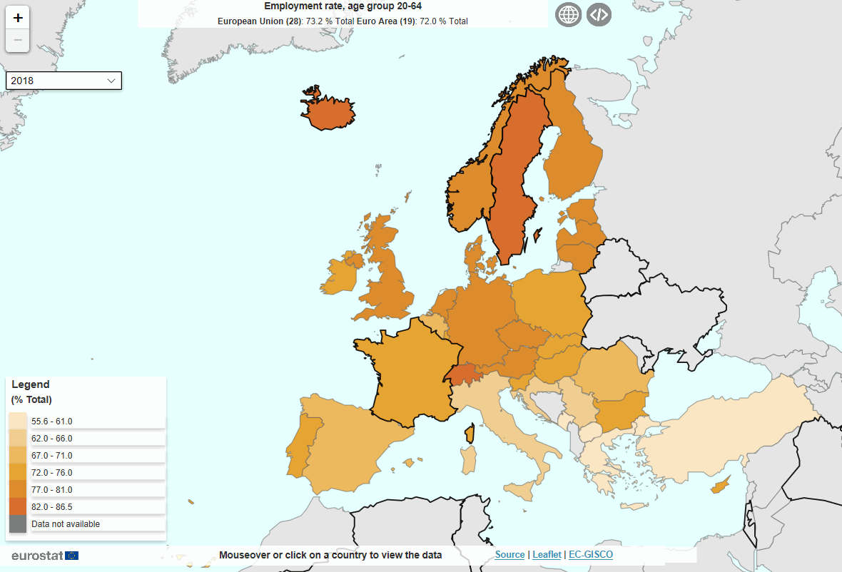
Recent developments in pensions and on the labour market in Poland 2017-2019 (4)
Eurostat, Statistics Explained, April 2019

Slide 13
Recent developments in pensions and on the labour market in Poland 2017-2019 (5)
Eurostat Newsrelease, 25 April 2019

Slide 14
Recent developments in pensions and on the labour market in Poland 2017-2019 (6)
Eurostat Newsrelease, 25 April 2019

Slide 15
4. Why and how to adjust retirement age to longer life?
GUS 2019, Life expectancy tables of Poland 2018, p. 13

Slide 16
Why and how to adjust retirement age to longer life? (2)
Why?
Possible solutions when demographic/ economic dependency is growing:
Increasing contributions/ taxes
Lowering pensions
Raising the retirement age
All these solutions are unpleasant, but raising the retirement age is the best!

Slide 17
Why and how to adjust retirement age to longer life? (3)
How?
Other pension system rules matter, especially:
Generosity of pension
system
Possibilities to combine
pensions and earnings
from work

Slide 18
Why and how to adjust retirement age to longer life? (4)
How? (2)
Difficult in times of populism
Education is crucial
Showing people that there is no simple answer
Role of schools, universities, media…

Slide 19

Thank you very much for your attention!
maciej.zukowski@ue.poznan.pl

