Slide 1
The readability of Polish individual pension contracts
Milena Hadryan, Ph. D., Adam Mickiewicz University Poznań
Research within NCN project
”Readability, transparency and efficiency of individual pension products” (2016/21/D/HS5/03905

Slide 2
NCN „Readability, transparency and efficiency of individual pension products”
Joanna Rutecka-Góra, Ph.D., Warsaw School of Economics
Kamila Bielawska, Ph.D, Gdańsk University
Sylwia Kamieniecka, Ph.D, University of Warmia and Mazury in Olsztyn
Patrycja Kowalczyk-Rólczyńska, Ph.D, Wrocław University of Economics
Milena Hadryan, Ph.D, Adam Mickiewicz University, Poznań

Slide 3
Interdisciplinary project (NCN) „Readability, transparency and efficiency of individual pension products”
Previous research concentrated on readability of texts (e.g. Pisarek 1966; Banach 2011, Broda, Ogrodniczuk, Nitoń i Gruszczyński 2014)
This interdisciplinary research connects readability and transparency of texts with efficiency of the products they present
The researcher represent two disciplines: economics and linguistics
.

Slide 4
Research backgrounds
Scope: Individual pension products on the Polish market IKE (Individual Saving Accounts) and IKZE (Individual Retirement Saving Accounts) offered in 2016
Object of analysis: general terms of contract (owu), product regulations (regulaminy), key information document (karty produktu)
Methods: automatic linguistic analysis by the application Jasnopis (readability) and expert evaluation (transparency)

Slide 5
Individual pension products
IKE were offered in 2016 by:
  12 life insurance agencies (ZUnŻ)
  16 asset management companies (TFI)
  6 brokerage houses (DM)
  12 banks
  4 voluntary pension funds managed by pension societies (PTE)
IKZE were offered in 2016 by:
  7 life insurance agencies (ZUnŻ)
  13 asset management companies (TFI)
  5 brokerage houses (DM)
  3 banks
  8 voluntary pension funds managed by pension societies (PTE)
Number of analysed documents:
  15 products offered by life insurance agencies (ZUnŻ)
31 products offered by asset management companies (TFI)
10 products offered by brokerage houses
9 products offered by banks,
12 products offered by voluntary pension funds (DFE)
Totally 77 products

Slide 6
Difficulty versus readability versus transparency
Difficulty is an objective text feature. It can be measured by objective indexes (e.g. Pisarek-index) based on word och sentence length.
Readability is a feature connected to the text recepient: his/her reading ability, knowledge, engagemang etc.
Transparency is the quality of graphic text representation
Badanie zrealizowano w ramach projektu finansowanego ze środków NCN
„Zrozumiałość, przejrzystość i efektywność indywidualnych produktów emerytalnych” (nr grantu 2016/21/D/HS5/03905)

Slide 7
Readability
Readability class measured by the application Jasnopis (ww.jasnopis.pl):
1 – simple text (class 1–3 primary school),
2 – very easy text (class 3–6 primary school),
3 – easy text, comprehensible for average Poles (middle school),
4 – text a little bit more difficult, comprehensible for people with high school education) (high school),
5 – text comprehensible for educated people with bachelor’s degree,
6 – text difficult for average Poles (Master’s degree),
7 – text very complicated, it requires specialized knowledge (e.g. Phd thesis in the current discipline)
Other measures used ind the analysis:
(Gunning) FOG index – based on words and sentence length, inicates the number of years needid to understand a text,
Pisarek index – informs about how many education years are needid to understand a text,
Percent of verbs in total number of words (the more verbs, the more comprehensible text)

Slide 8
Readability – results
 | Number of documents in each difficulty class
Jasnopis difficulty class (+ FOG index , % czasowników) | Life Insurance companies | Asset management companies (TFI) | Brokerage houses | Banks | Voluntary pension funds
7 | 9 (9,72 – 14,06, 5-6%) | 2 (11,18 -11,19, 7%) | - | 1 (9,9, 5%) | 2 (9,51-9,96, 5-6%)
6 | 9 (5,15-14,79,6-9%) | 27 (6,79-12,86, 6-9%) | 6 (6,27 -11,89, 5-8%) | 8 (8,46-10,66, 6-7%) | 10 (6,37-11,47; 6-8%)
5 | 2 (10,86-11,04, 9-10% | - | - | -
4 | - | 1 ? (3,63, 6%) | - | -
3 | - | - | - | -
2 | - | - | - | -
1 | - | - | - | -
Source: M. Hadryan, J. Rutecka-Góra, Analiza zrozumiałości treści umów indywidualnych produktów emerytalnych z wykorzystaniem aplikacji Jasnopis i omówieniem lingwistycznej specyfiki tych umów, raport badawczy, SGH Warsaw, Warsaw 2017 (not published).

Slide 9
AXA-ZU_IKZE-owu long nominal phrases
§ 5
1. Z zastrzeżeniem postanowień ust. 2 poniżej, aktywa Funduszu są inwestowane w całości w jednostki uczestnictwa funduszu inwestycyjnego otwartego lub w całości w inne tytuły uczestnictwa, umarzane na żądanie, emitowane przez instytucję wspólnego inwestowania, mającą siedzibę na terytorium państwa członkowskiego Unii Europejskiej.
2. Aktywa Funduszu mogą być lokowane poza granicami państw członkowskich Unii Europejskiej zgodnie z zasadami określonymi w zezwoleniu ogólnym, udzielonym przez ministra właściwego do spraw instytucji finansowych w drodze rozporządzenia, na uznawanie za środki stanowiące pokrycie rezerw techniczno-ubezpieczeniowych aktywów znajdujących się poza granicami państw członkowskich Unii Europejskiej.
2. Charakterystykę aktywów otwartego funduszu inwestycyjnego, kryteria doboru jego aktywów oraz zasady ich dywersyfikacji i inne ograniczenia inwestycyjne określa statut funduszu inwestycyjnego otwartego, w którego jednostki uczestnictwa są lokowane aktywa Funduszu, a w przypadku innych tytułów uczestnictwa umarzanych na żądanie, emitowanych przez instytucję wspólnego inwestowania mającą siedzibę poza terytorium Polski - właściwe dokumenty regulujące organizację i funkcjonowanie takiej instytucji zgodnie z przepisami prawa dla niej właściwego.

Slide 10
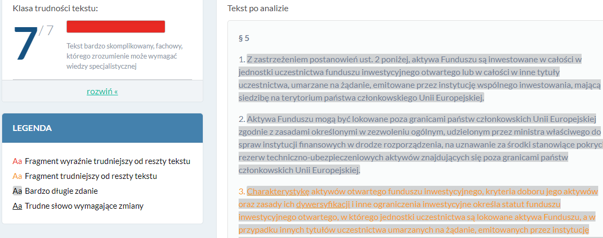

Slide 11
Transparency
Transparency is a set of text and paratext features (graphic) which influense the readability of text:
The features set chosen for the reaserch:
typeface and typesize
structure
graphics
metatext (e.g. summary)
direct expressions (e.g. Read!)
For each feature a document could get 1 pkt, it could be totally valued by 0-5 pkt.

Slide 12
Transparency – results
 | Number of institutions which got a certain number of points
Points | Life insurance companies | Asset management companies (TFI) | Brokerage houses | Banks | Voluntary pension funds (DFE)
0 | - | 2 | - | 2 | 2
1 | 3 | 12 | 2 | 6 | 3
2 | 10 | 10 | 2 | 1 | 7
3 | 5 | 6 | 2 | - | 2
4 | - | - | - | - | -
5 | 2 | - | - | - | -
Source: M. Hadryan, Lingwistyczna analiza przejrzystości dokumentów kształtujących treść umów indywidualnych kont emerytalnych (IKE) i indywidualnych kont zabezpieczenia emerytalnego (IKZE), raport badawczy, SGH Warsaw, Warsaw 2017 (not published).

Slide 13
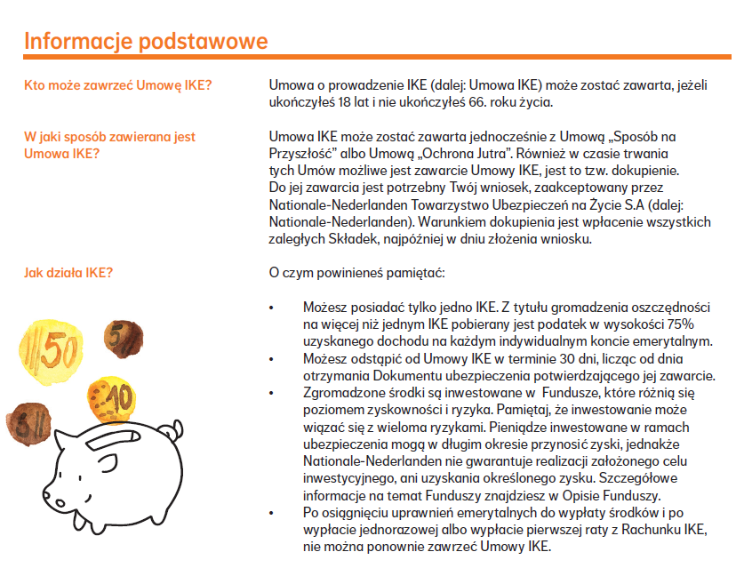

Slide 14
Text readability versus text transparency
Transparency is more differentiated than readability.
The most transparent text (NN_ZU_IKE_owu) represents readability Jasnopis class 6 (=difficult text).
The most readable texts (PZU_ZU_IKE_KartaProduktu/ PZU_ZU_IKZE_KartaProduktu ) represents readability class 5 and has an avarage transparency (3 p. for scale 0-5).
There is no strict relation between transparency and readability class noticed (e.g. readable texts class 5 has rather poor transparency).

Slide 15
Conclusions
Individual pension contracts are not reader-friendly (to small typefaces, lack of metatext and direct expressions).
The more common advantage of those documents are often used, visible subheading.
The most transparent texts are texts of life insurance companies (especially general insurance conditions of PZU and nationale Nederlanden – 4 and 5 points)
The less transparent are bank documents.

Slide 16
Conclusions
To understand the individual pension contracts at least high-education is required. Allmost all of the contracts represent the readability class 6 or 7.
The documents are not very readable, but the rather poor transparency makes them even less reader-friendly.

Slide 17
Thank you for your attention!
Milena Hadryan
milenah@amu.edu.pl

