Slide 1
Public vs. private
Key issues for rethinking in pension economics
Marek Góra
Polish Pension Group, Warsaw School of Economics

Slide 2
Free choice vs. mandatory participation
Individual free choice is essencial. However, it is insufficient
Mandatory participation in pension schemes is needed to reduce information asymmetry (miopia, free riding, and so on)
Mandating people to participate is not a goal – It is the method to ensure universal participation
An open question is the scale of mandatory participation and organisation of a universal pension scheme

Slide 3
Concentration of risk
Private means free choice of: participation itself, scale of participation, form of participation, length of participation, and so on
Private also means concentrated risk of good and bad outcomes of participation
Public means standardised universal rules of mandatory participation, in other words no choice of limited choice
Public also means risk spread over the entire population
Ill-designed schemes when there is free choice and risk is spread. Then the strong can benefit at the expanse of the weak

Slide 4
Type of scheme
A scheme covering the entire population does not allow for free choice. That system is public by definitione
The ownership type of an institution running a universal system does not determine the type of the scheme itself

Slide 5
UPPS – a devise of income allocation over life cycle
A universal public OA pension scheme (UPPS) as a government-mandated lifecycle longevity insurance scheme that transfers individual consumption from the working years to the retirement phase of the lifecycle
UPPS – transfer of income is mandatory for everyone, and under the same rules for everyone, although it is the way of managing contribution flows differs between nonfinancial and financial UPPSs.

Slide 6
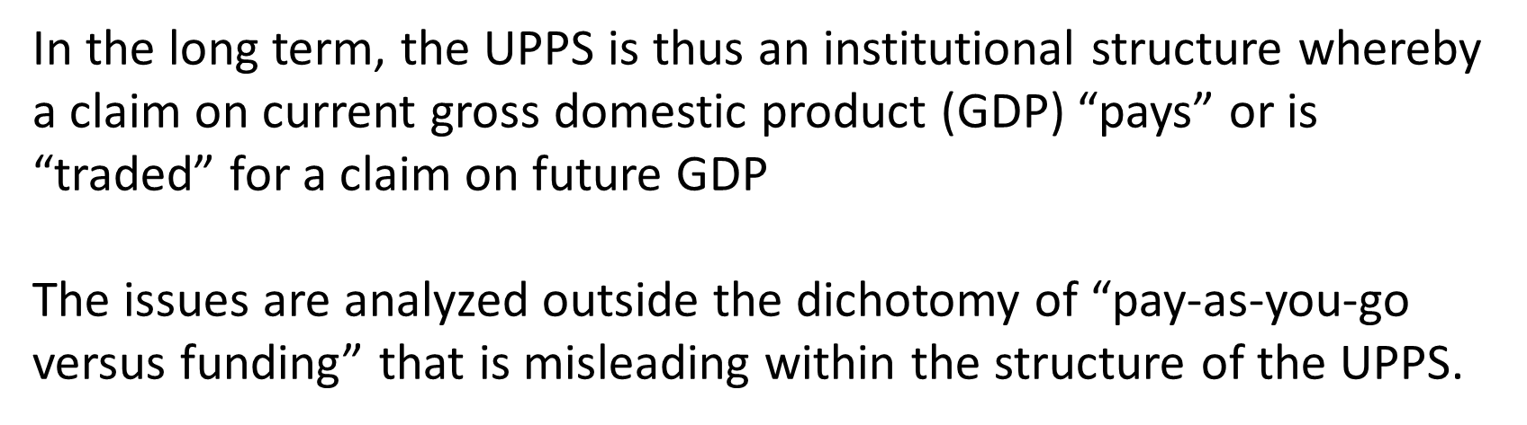
Beyond PAYG vs. funding

Slide 7
Macro/micro vs. micro
UPPSs are macro pension schemes with micro properties, while private pension schemes are solely micro – by definition. This distinguishing property of UPPSs. Whereas individual private “micro” pension schemes by themselves are unlikely to interact significantly with the macro economy, a UPPS interacts with the macro economy by definition.

Slide 8
Provider vs. specific functions
In a UPPS the public provider is responsible for the scheme, although some or all of the specific functions – i.e., collection of revenues, account keeping, information to participants, financial portfolio management, etc. – can be performed by either public institutions or private firms.

Slide 9
The pay-as-you-go (“public”) versus funding (“private”) is based on a two-way distinction that fails to recognize that a public scheme can be either a nonfinancial or a financial DC. More generally, that nomenclature completely misses: the fundamental role of a UPPS in providing lifecycle longevity insurance; and the distinction between UPPSs and the private schemes that emerge to provide insurance for subgroups of the working population.

Slide 10
Distinguishing characteristics of UPPSs

Slide 11
Tax financing vs. savins financing
The act of paying contributions into a pension scheme performs the function of transferring individual consumption possibilities from the present into the future. The difference is the strength of the link on an individual basis. If the link is 1:1 then even though participation is mandatory and thus unavoidable, it is not a tax by definition if one defines a tax as relinquishing income to the tax authority to provide general revenues that in the end may or may not return to the taxpayer.

Slide 12
Public vs. private
The word “private” does not play any role in this context. The four schemes of relevance are all publicly mandated and differ from each other through their designs. However, they may have functions that can be contracted out to privately managed companies, such as portfolio management.

Slide 13
Transparent and automatic income allocation
Saving is a result of forgoing current consumption out of current income.
The intention of UPPS-DC is that the unit of money paid is a liability to be repaid with interest to the payee – which can be called forced saving.

Slide 14
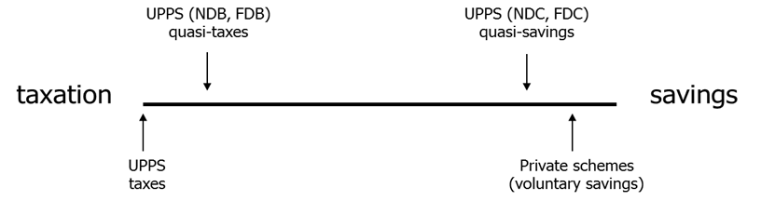
Public perception of various types of income allocation over life cycle

Slide 15
Conclusion
The traditional dichotomy of pay-as-you-go (which implies “public”) versus funding (which implies “private”) is partially idle and also may be misleading.
That dichotomy can be replaced with the double dichotomy of financial versus nonfinancial and defined benefit versus defined contribution.
Crucial distinction within UPPS: tax financing vs. savings financing

Slide 16
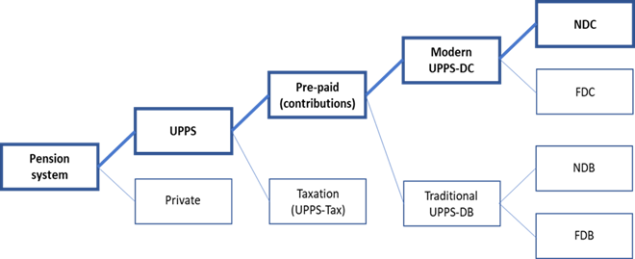
The evolution of thinking on public pension schemes
Savings
Quasi
tax

Slide 17
Basic background
Also forthcoming in “Progress and Challenges of Nonfinancial Defined Pension Schemes”. Editors: Robert Holzmann, Edward Palmer, Robert Palacios, and Stefano Sacchi. World Bank. Washington, 2019

