Slide 1
mutual funds as instruments for pension security the case of poland
Łukasz Dopierała
Magdalena Mosionek-Schweda
Daria Ilczuk
University of Gdańsk

Slide 2
Mutual funds in the third pillar in Poland
Individual pension accounts (indywidualne konta emerytalne, IKE)
Individual pension security accounts (indywidualne konta zabezpieczenia emerytalnego, IKZE)

Slide 3
Mutual funds in the third pillar in Poland
IKE
IKZE

Slide 4
The number of particular mutual funds in IKE and IKZE offer (as of 30.01.2019)
IKE
IKZE
Source: https://www.analizy.pl

Slide 5
The main purpose of this presentation is to assess mutual funds as instruments for additional pension security on the example of Poland.

Slide 6
Review of previous research
Most publication focus on pension funds (Bohl et al., 2011; Chybalski, 2006; Karpio and Żebrowska-Suchodolska, 2014, 2017; Mikulec, 2004; Witkowska and Kompa, 2015)
Some papers focus on products offered by life insurance companies (Cwynar at al., 2016; Dopierała, 2017, 2018)
Many studies devoted to the mutual funds’ performance, for example: Agarwal and Pradhan, 2018; Babalos et al., 2012; Bangash, 2012; Perez, 2012; Zamojska 2012

Slide 7
Data and methodology
weekly valuation of participation units
long-term analysis (2009-2019), sample: 114 funds
medium-term analysis (2014-2019), sample: 161 funds
types of funds: equity, mixed assets and fixed income
We also took into consideration open pension funds (OFE),
which will be probably transformed into open-end investment funds operating under IKE.

Slide 8
Data and methodology
Profitability assessment:
simple rate of return
Evaluation of the investment efficiency:
Sharpe ratio
Assessment of the fund type impact
on its profitability and investment efficiency:
Kruskal-Wallis test
Post-hoc multiple comparisons:
Siegel-Castellan test

Slide 9
Annual return – descriptive statistics

Slide 10
Profitability of mutual funds and OFE

Slide 11
Annual return - Kruskal-Wallis test and p-value for post-hoc multiple comparisons

Slide 12
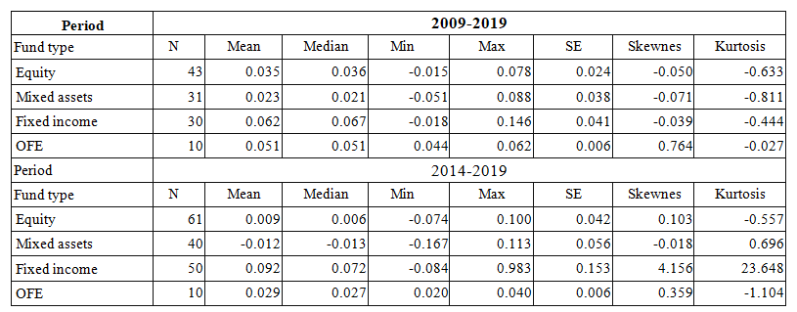
Sharpe ratio – descriptive statistics

Slide 13
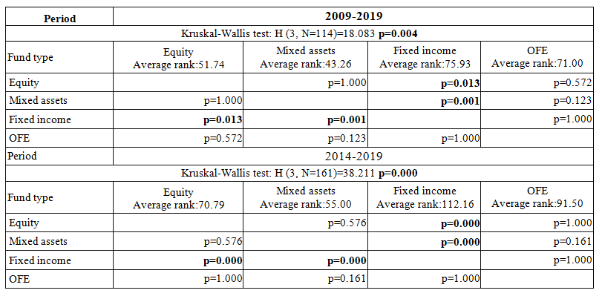
Sharpe ratio – Kruskal-Wallis test and p-value for post-hoc multiple comparisons

Slide 14
Conclusions
Type of mutual funds has a significant impact
on the investment efficiency
The highest investment efficiency was achieved
by fixed income funds
Profitability of OFE was particularly high
in the period of 2014-2019
Majority of OFE achieved better efficiency than
a passive portfolio based on the WIG index
in the period of 2009-2019

Slide 15
Possible extensions
Impact of firm size and value:
Fama-French 3-factor model (1993)
Momentum:
Carhart 4-factor model (1997)
Market timing:
Henriksson-Merton model (1981)
Conditional measures:
Ferson-Schadt model (1996)

Slide 16
Thank you for your attention
Łukasz Dopierała
Magdalena Mosionek-Schweda
Daria Ilczuk
University of Gdańsk

