Slide 1



Trade-off between contribution and benefit variability in a hybrid pension scheme
Social Security Systems in the Light of Demographic,
Economic and Technological Challenges
Poznan 2019
Anna Gierusz, University of Gdansk, anna.gierusz@ug.edu.pl

Slide 2
Hybrid pension schemes
Reduction of employer contribution variability vs DB scheme
Reduction of member benefit variability vs DC scheme
Conditional contribution pension scheme:
Target benefit set
Contribution recalculated every year based on actual experience
Maximum variability of employer contribution set (K)
If actual contribution exceeds this maximum benefit is adjusted

Slide 3
Assumptions
Assumption | Value
Member’s age on joining the scheme | 25
Retirement age | 65
Target replacement rate (% of final salary) | 30%
Minimum replacement rate (% of final salary) | 25%
Annual rate of investment returns (pre-retirement) | 3.4%
Annual interest rate (post-retirement) | 1%
Annual rate of salary increase | 1.5%
Annual administration charge pre-retirement (% of fund) | 0.5%
Administration charge post-retirement (% of payment) | 1%
Remaining lifetime in years at age 65 | 23
Contribution rate 11.8% (5.9% member and employer each)

Slide 4
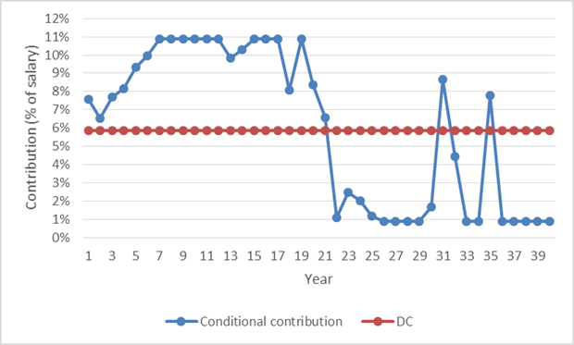
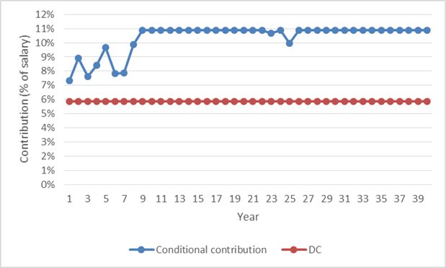
Selected scenarios – employer contribution
Average variability of employer contribution: 4%
Replacement rate achieved: 0.38
Replacement rate in DC scheme: 0.35
Average variability of employer contribution: 4.5%
Replacement rate achieved: 0.17
Replacement rate in DC scheme: 0.12

Slide 5
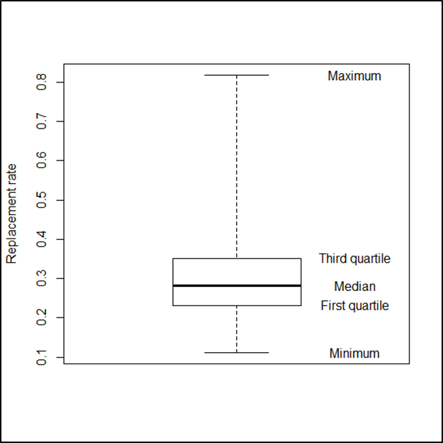
Results – DC scheme
Average replacement rate | 0.303
Standard deviation of replacement rate | 0.1
Lowest replacement rate | 0.11
Replacement rate lower than 0.25 in | 34% of scenarios
Average variability of contribution rate to achieve target | 6.9% of salary

Slide 6
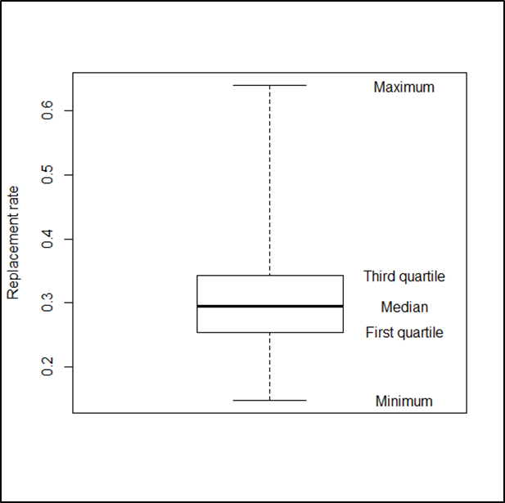
Results – Conditional contribution scheme
K = 5%
Average replacement rate | 0.306
Standard deviation of replacement rate | 0.07
Lowest replacement rate | 0.15
Replacement rate lower than 0.25 in | 22%
Average variability of employer contribution rate | 3.1%

Slide 7
Analysis of sensitivity
Value of K | Average difference between employer’s contribution and set DC contribution | Standard deviation of member’s replacement rate | Percentage of scenarios for which member’s replacement rate was lower than 0.25
4% | 2.7% | 0.077 | 25%
5% | 3.1% | 0.073 | 22%
6% | 3.5% | 0.069 | 21%

Slide 8
Comparison with other hybrid schemes
Scheme | Average difference between employer’s contribution and set contribution | Standard deviation of member’s replacement rate | Percentage of scenarios for which member’s replacement rate was lower than 0.25
DC | 0.0% | 0.100 | 34%
Conditional contribution (K=5%) | 3.1% | 0.073 | 22%
DC with an underpin (minimum replacement rate 0.25) | 1.0% | 0.087 | 0%
Combination hybrid (DB and DC sections) | 3.5% | 0.050 | 13%

Slide 9
Conclusions
Introducing risk sharing decreases variability of member’s benefit: standard deviation of replacement rate decreases from 0.1 in a DC scheme to 0.07 in a conditional contribution scheme (K = 5%).
Changing the value of K by one percentage point changes:
  average difference in employer’s contribution and set DC contribution by about 0.4 percentage points,
  standard deviation of member’s replacement rate by 0.004 of final salary.

