Slide 1

Lessons from the polish pension reforms
Joanna Ratajczak
Kamila Bielawska
Joanna Rutecka-Góra
Marek Szczepański
Sylwia PIEŃKOWSKA-KAMIENIECKA

Slide 2
Agenda
Background of the pension reform 1999
The pension reform of 1999: goals, design, implementation
Rethinking the pension reform - political risk and key changes
  public pension scheme
  occupational pension scheme
  individual pension savings
Further expected changes (under discussion)
Conclusions

Slide 3
Background of the Pension reform 1999
The Pension system before 1999 – main features
wide coverage
easy access to the pension provision
DB pension formula: complicated, highly redistributive, numerous pension privileges; high replacement rates and pension adjustment
low acceptance of the pension system in the society
very low rate of voluntary pension savings; lack of employment related pension schemes

Slide 4
Background of the Pension reform 1999
The Pension system before 1999 – environment
2002
2030
Demography:
  growing old age dependency ratio
  relatively weak health condition
Economy: consequences of transition process - relatively high unemployment rates (20%), real reduction of GDP in 1990-1991; growing shadow economy, reduction of state intervention (like price subsidies)
100+
100+
90
90
Mężczyźni
80
Kobiety
Mężczyźni
80
Kobiety
70
70
60
60
50
50
40
40
30
30
20
20
10
10
400
300
200
100
0
0
100
200
300
400
400
300
200
100
0
0
100
200
300
400
ths
ths

Slide 5
Background of the Pension reform 1999
The Pension system before 1999 – environment
Projected financial instability of the social insurance fund:
    Pension expenditures would increase from 11% of GDP in 2000 to 17.3% in 2050
    By the same time, the number of pensioners would double from 7 million in 2000 to almost 15 million in 2050
    Total pension deficit would exceed 7% of GDP
Politics: frequent government changes; little experience with implementation of (paradigmatic) reforms
Society and public: distrust for authorities, anxiety about changes and reforms, defence of status quo, low economic and pension awareness

Slide 6
The Pension reform of 1999: goals, design, implementation
Principles and goals of the Pension reform 1999
financial sustainability of the public pension system in the long term
boosting economic growth
terminating further increase of contribution rate for public social insurance, protecting future generations from excessive social security burden and creating the space for supplementary pension provision,
reduction of redistribution in the public pension system and making it more equivalent
Security through diversity: Reform of the pension system in Poland.
Office of the Government Plenipotentiary for Social Security Reform, 1997

Slide 7
The Pension reform of 1999: goals, design, implementation
Design of the Pension reform 1999
1st Pillar | 2nd Pillar | 3rd Pillar
First tier - Public pension scheme with the guarantee of minimum pension financed from general revenue (state budget) |  | Second tier – occupational pension scheme | Third tier - individual pension savings
Mandatory |  | Voluntary
19,52% |  | up to 7% of the salary | no contribution limits, no state support
12,22% | 7,3%
individual pension accounts
NDC | FDC | FDC | FDC
old-age pension fund within Social Insurance Fund (FUS) managed by Social Insurance Institution (ZUS) | Open Pension Funds (OFE) privately managed by pension fund companies (PTE) | Employee Pension Plans (PPE) | all kinds of individual savings

Slide 8
The Pension reform of 1999: goals, design, implementation price for political consensus
the separate pension subsystem for some groups (farmers, judges and prosecutors, uniform workers),
no changes in the minimum retirement age for women and men
the indexation in the first pillar was more generous,
for those, who acquired the pension in the years 2009-2013 a mixed old-new pension formula was used (to smooth decrease of the replacement rate)
Unsolved and unregulated issues:
phasing out early pensions and solving the issue of bridge pensions,
paying out pensions from the mandatory funded pillar,
establishment of state actuary,
reform of disability pensions

Slide 9
Rethinking the pension reform - political risk and key changes public pension scheme
Aimed at the pension provision from the 1st pillar directly
Aimed at the modification within the 2nd funded pillar
Aimed at the “relation” between 1st PAYG and 2nd funded pillar

Slide 10
Rethinking the pension reform - political risk and key changes public pension scheme – 1st pillar directly
? - cancellation of the pension contribution base ceilings
2017 – cancellation of gradual increse in and equalisation of the minimum retirement age
2014 – implementation of partial pensions
2013 – start of gradual raising and equalisation of the minimum retirement age for women and men
2009 – implementation of the old-age bridging pensions and phasing out early pensions
2000 – guarantee of non-negative indexation of pension rights (NDC)

Slide 11
Rethinking the pension reform - political risk and key changes public pension scheme – 2nd pillar directly
? - termination of OFE with default option of transferring assets into individual pension accounts at the cost of 15% fee for the state
2014 – „big reform” of OFE → OFE as voluntary part of the pension system; change of investment strategy of OFEs, redeeming of T-bonds holded by OFEs, „security” slide of 10 years, reduction of fees, no internal benchmark and minimum rate of return
2011 – continuation of cost reductions, changes in investment policy, aquisition ban
2009 – finalising rules for payout phase from OFEs (temporary programed withdrawal up to age 65 and annuity since year 65 for men and women)
2004 – changes in fees to increase cost-effectiveness of OFEs

Slide 12
Rethinking the pension reform - political risk and key changes public pension scheme - “relation” between 1st PAYG and 2nd funded pillar
 | 1. Pillar (FUS) – individual account | 1. Pillar (FUS) – individual subaccount | 2. Pillar (OFE) individual account
from August 2014 | 12,22% obligatory | 4,38% | 2,92% voluntary
 | 12,22% obligatory | 7,3% | 0%
February 2014 – June 2014 | 12,22% obligatory | 4,38% obligatory | 2,92% obligatory
May 2011 – January 2014 | 12,22% obligatory | 5%→4,2% obligatory | 2,3% → 3,1% obligatory
1999 – April 2011 | 12,22% obligatory |  | 7,3% obligatory

Slide 13
Rethinking THE PENSION REFORM – POLITICAL RISK AND KEY CHANgES
INDIVIDUAL PENSION SAVINGS
INDIVIDUAL RETIREMENT ACCOUNTS (Indywidualne Konta Emerytalne, IKE) – implemented in 2004.
providers: various financial institutions such as asset management companies, life insurers, banks, pension societies and brokerage houses.
The most popular IKE products take the form of life insurance contracts (unit-linked life insurance) and investment funds. According to official data (KNF 2019), these two forms of plans represented 87% of all IKE accounts at the end of 2018.
Contribution limit of 300% of an average monthly wage. TEE regime.
The total amount of IKE assets amounted to PLN 8.7 billion (€2.02 billion) as of 31 December 2018.
An average IKE account balance is PLN 8,729 (€2,029) that seems not to guarantee an adequate supplementary pension income.
At the end of 2018 only 995,651 Polish citizens had an individual retirement account (IKE) which represents 5.8% of the working population.

Slide 14
Rethinking THE PENSION REFORM – POLITICAL RISK AND KEY CHANgES
INDIVIDUAL PENSION SAVINGS
Number of Individual Retirement Accounts (IKEs) in the years 2004-2018 by financial provider
Source: authors’ own collaboration based on KNF (Polish Finacial Supervision Authority) data.

Slide 15
Rethinking THE PENSION REFORM – POLITICAL RISK AND KEY CHANgES
INDIVIDUAL PENSION SAVINGS
INDIVIDUAL RETIREMENT SAVINGS ACCOUNTS (Indywidualne Konta Zabezpieczenia Emerytalnego, IKZE) - implemented in 2012.
They are offered in the same product forms as individual retirement accounts (IKE) but have other contribution ceilings and offer a different tax relief (EET regime with reduced tax rate at pay-off).
Life insurance companies manage 61% of the accounts.
The limit for IKZE contributions is 120% of the average monthly wage (PLN 5,718 - €1,329.33 in 2019).
Assets under management (AuM) PLN 2.3 billion (€0.53 billion). The average account balance (2018) - PLN 3,169 (€737)
Small coverage: only about 4.3% of the Polish working population (2018) is covered by IKZE.

Slide 16
Rethinking THE PENSION REFORM – POLITICAL RISK AND KEY CHANgES
INDIVIDUAL PENSION SAVINGS
Number of Individual Retirement Savings Accounts (IKZEs) in the years 2012-2018 by financial provider
Source: authors’ own collaboration based on KNF (Polish Finacial Supervision Authority) data.

Slide 17
Rethinking THE PENSION REFORM – POLITICAL RISK AND KEY CHANgES
INDIVIDUAL PENSION SAVINGS
Individual pension market problems and challenges:
active participation rate 33,8 % (IKEs) and 31,4% (IKZEs) and even smaller when taking into account the contribution deductions from the tax base
usage of contribution limits (ca. 30% in IKEs and ca. 62% in IKZEs)
account balances => risk of inadequate supplementary old-age pensions
2/3 of IKZE savers deducting contributions from tax base (2017) belong to 20% of the most affluent individuals – income redistribution towards the well-off

Slide 18
Rethinking THE PENSION REFORM – POLITICAL RISK AND KEY CHANgES
INDIVIDUAL PENSION SAVINGS
Major barriers affecting the development of IKEs and IKZEs:
low pension awareness of Poles
high complexity and unreadability of pension products
lack of transparency of individual pension market
inadequate information policy (neither official register of individual pension products nor any official ranking of individual pension plans)
high level and complex structure of costs
problems with assessment of the efficiency of pension products
ineffective fiscal incentives.

Slide 19
Rethinking THE PENSION REFORM – POLITICAL RISK AND KEY CHANgES
OCCUPATIONAL PENSION SAVINGS
In the first five years of the implementation of the pension reform, from 1999 until 2004 ((until the introduction of individual retirement accounts – IKEs in 2004) the only form of saving for retirement, were Employee Pension Plans (PPEs).
Employee Pension Plans (PPEs) are a voluntary form of group saving for retirement, organized by employers in cooperation with employees (a company or inter-company program).
The basic contribution is financed by employers (till 7% of gross wages), while employees may voluntarily make additional payments from own resources as an additional contribution.
4 forms of PPEs:
an employee pension fund
a mutual-investment fund
a group life insurance contract with life insurance fund
foreign management
Contributions are taxed. There is a tax relief for capital gains. Benefits are not taxable (“TEE” regime).

Slide 20
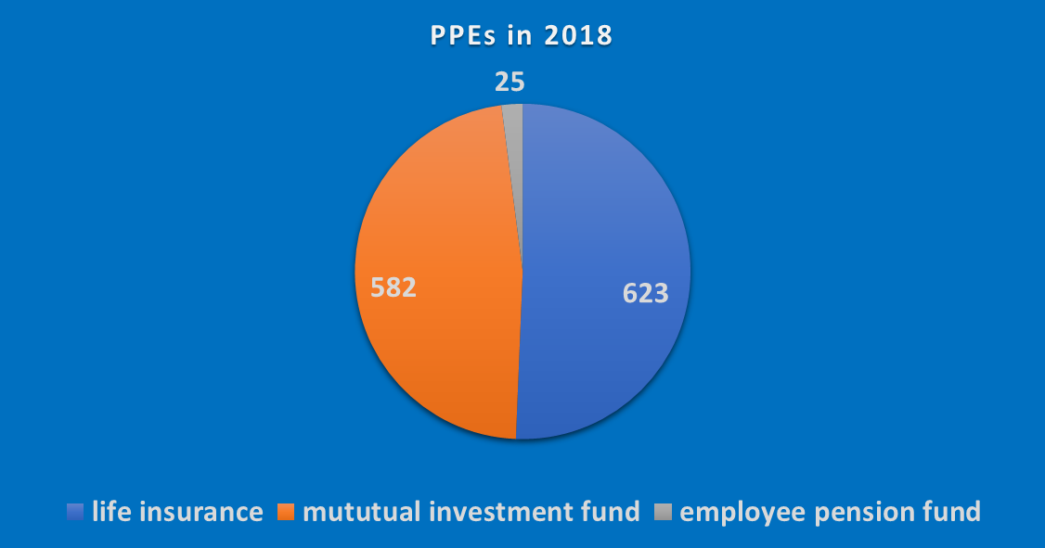
Rethinking THE PENSION REFORM – POLITICAL RISK AND KEY CHANgES
OCCUPATIONAL PENSION SAVINGS
426 tsd. participants
at the end of 2018
Assets about 3.8 bln euro
Coverage: only 2.6% of
labour force
Source: KNF (Polish Financial Supervision Authority)

Slide 21
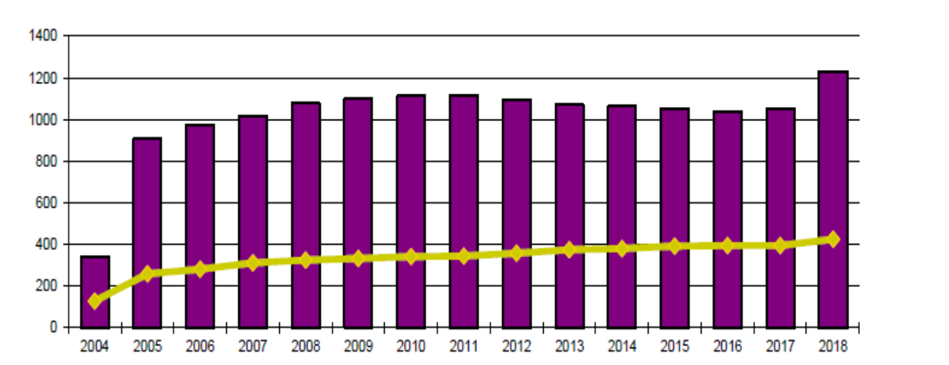
Rethinking THE PENSION REFORM – POLITICAL RISK AND KEY CHANgES
OCCUPATIONAL PENSION SAVINGS
The numer of PPEs and the numer of participants from 2004 till 2018
Number
of PPEs
Number
of participants (in tsd.)
Source: KNF (Polish Financial Supervision Authority)

Slide 22
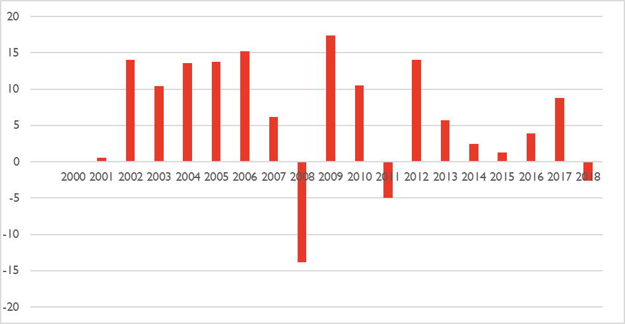
Rethinking THE PENSION REFORM – POLITICAL RISK AND KEY CHANgES
OCCUPATIONAL PENSION SAVINGS
From the free forms of occupational pension schemes operating on the market since 1999, as already mentioned, only statistical data on the value of participation units (after deducting service costs) of Employee Pension Funds (PFE) has been published in a systematic manner and can be used to assess their investment performance The fourth form introduced later as an adjustment to EU regulations were Employee Pension Plans (PPE) with foreign management, but none of such plans has been created.
Rates of return on investment in Employee Pension Fund (PFE) “Nowy Świat“ 2000-2018
Source: KNF (Polish Financial Supervision Authority)

Slide 23
Rethinking THE PENSION REFORM – POLITICAL RISK AND KEY CHANgES
OCCUPATIONAL PENSION SAVINGS
Analyzing the development of PPEs in the long run, one can notice a very slow increase in active programs.
The research conducted on a representative sample of employers offering PPEs in the years 1999-2010 (Szczepański 2010) shows that in the analyzed period there were more slowing down variables than those stimulating the development of employee pension schemes. In such a situation it is not surprising that this development took place in a very slow and limited way and covered a scanty share of employees.
The identified barriers to the development of PPEs can be divided into exogenous (external) - mainly of an economic and institutional nature, and endogenous (internal) ones - concerning employers and employees.
The main development barriers:
Keeping a high scope of the obligatory system in the reformed pension scheme (1st and 2nd pillar, which in total receive nearly 20% of salaries which constitute the base for calculating social insurance premiums), which leaves limited “space” for the development of supplementary systems (3rd pillar), including employee pension plans.
Insufficient economic and fiscal incentives offered to employers.
Still a significantly lower level of average salary in Poland vs. an average in old EU Member states.

Slide 24
Rethinking THE PENSION REFORM – POLITICAL RISK AND KEY CHANgES
OCCUPATIONAL PENSION SAVINGS
From June 2019 - establishing a new occupational pension savings scheme:
EMPLOYEE CAPITAL PLANS (Pracownicze Programy Kapitałowe, PPKs), with automatic-enrolment.
Expected coverage: around 11.5 million people (according to government estimates),
PPKs will be introduced gradually: from July 2019, they will cover workers in big companies (more than 250 employees); from January 2020, they will cover workers in medium-sized companies (50-249 employees); from July 2020, they will cover workers in small companies (20-49 employees); from January 2021, they will cover all remaining workers.
Incentives based on behavioral economics („Nudges”) – default options (status quo bias, loss aversion).
The scheme will cover all employees hired in accordance with the Labour Code contract who are between 19 and 55 years old. Workers aged between 55 and 70 can join an ECP voluntarily. The default option is participation in the plan, but anybody can opt out of ECPs at any moment.
Savings accumulated will be accessible only when the participant reaches the age of 60 (with the exception of cases of serious illness or if using part of the savings for housing purposes).

Slide 25
Rethinking THE PENSION REFORM – POLITICAL RISK AND KEY CHANgES
OCCUPATIONAL PENSION SAVINGS
Contributions to PPKs will be financed by employers, employees and the State budget (namely, the Labour Fund, which is used to finance unemployment benefits and active labour market policies).
The mandatory contribution will amount to 3.5% of the wage, with an optional additional contribution of up to 4.5% of the wage.
Amount of PPK contributions | Mandatory contributions | Voluntary contributions
Finaced by employer | 1.5% of the wage (with exemptions*) | up to 2.5% of the wage
Financed by employee | 2.0% of the wage (with exeptions**) | up to 2.0% of the wage
Source: own elaboration
*Companies which will offer PPE with at least 3.5% contribution from employer
till the date obligatory establishement of PPKs are exempted from obligation to create PPK
**Employees with salaries below 120% of the minimum wage will pay reduced mandatory contributions, but no less than 0.5% of their wage.

Slide 26
CONCLUSIONS (1/2):
Lessons from the Paradigmatic reform
Referring to the goals of the pension reform of 1999:
  Primary aims of the pension system were not sufficiently addressed: reduction of adequacy and increase of poverty ratio, especially for women
  Assessment of achievement of the secondary goals is confirmed by the development of the financial market, but the influence on the economic growth needs further research;
Referring to the implementation phase;
    All unsolved issues are easy to be modified or cancelled – they generate increase in political risk (OFE, financial sustainability)
    Transition costs matter (the reform must be affordable)
    other reforms should be in line with the pension reform
    Implementation phase and monitoring is as much important as a concept – the reform should have it „owner”

Slide 27
CONCLUSIONS (2/2):
Lessons from the Paradigmatic reform
Traditional incentives to additional pension savings (tax relieves) are not sufficient.
Social context and psychological aspects of pension reforms are at least as important
as institutional and economical issues.
Political risk and discontinuity of pension reforms may be the most important threat
in the continous process of pension reforms (not only in Poland).

