Slide 1
Self-employed persons in Czech Republic – winners or losers of the pension system Alena Vančurová, Stanislav Klazar, Eliska Cejkova department of public finance, University of Economics, Prague Poznan, 2019, September 19.

Slide 2
Motivation of research
Intro
Data
Methods
Results
Discussion
References
The topical issue within the pension system in the Czech Republic is the level of coverage of self-employed persons who constantly report their income near the level of minimal basis during their WHOLE lifetime.
Why now (2017…)? Time has come - the first wave of this kind of participant in the pension system (1st pillar) are ready to ask for their „minimal“ pensions – disillusion.
„disappointment resulting from the discovery that although their relative indicators are good, the real pension are not satisfying at all, so something is not as good as one believed it to be. “
Politicians begin to recognize this problem (MoLSA 2016 - Minister Marks appealed entrepreneurs: Please, pay more or…!) Public letter see below.

Slide 3
POLICY LETTER from ministry to people…
MPSV 2016 - Pokud živnostníci odvádí na důchodové pojištění minimum, dočkají se velmi malého důchodu, upozorňuje MPSV, online http://www.mpsv.cz/files/clanky/23593/TZ_MPSV_upozornuje_OSVC_na_mozny_nizky_duchod.pdf

Slide 4
Motivation of research background
Intro
Data
Methods
Results
Discussion
References
Political situation - No time for long run-fundamental reform of Czech pension system. Why? Bad experience from Second pillar (2016).
No time for fundamental reform… so it is ONLY time for some „outside of the system“ measures.
One of them is „to increase public literacy of lifetime saving, to increase ability to forecast the pension level“ to help them to make right decision.
We believe that "scientia potentia est" (knowledge is power) and our humble believe is that the results will help to the participants to make a right decision.

Slide 5
Aim of the paper
Intro
Data
Methods
Results
Discussion
References
We believe, that regardless of what demographic trends or developments in capital markets will be, early (though only approximate) knowledge of future pension benefits will help to participants make the right decisions.
In this paper we would like to show the “investment” position of self-employed person within the Czech pension system. We based our analysis on comparison of workers (as a benchmark, most common participant) and self-employed persons (which have a specific position in the system from many point of view).
We will estimate:
the nominal level of future pensions
replacement rates (RRs)
the lifetime efficiency of pension system
… for self employed person versus workers

Slide 6
Methodology and modelling
Intro
Data
Methods
Results
Discussion
References
We describe the Czech pension system with the focus on the benefits from the system and the payments to the system
We introduce simplified model for calculation of lifetime benefit and payment flows
We focus on the pros and cons of the dataset (if time availability)

Slide 7
Methodology and modelling II
Intro
Data
Methods
Results
Discussion
References
We estimate the standard measures of pension system efficiency
replacement rates,
lifetime (benefit/contribution) index)
using the unique dataset of Assessment Base for Pension Insurance to shed the light on this problem.

Slide 8
How large can be this problem?
Two aspects:
how much are Czech people as a whole dependent on public pension system. See next graph
AND
number of underfinanced person self-employed person. See results later.

Slide 9
Is focus on only first pillar enough? Income sources of older people, 2014 or latest available year

Slide 10
SSCs as % of GDP, the most important source of public budgets

Slide 11
Mini summary: Our system
allows them to pay only minimal contributions, but
do not reveals clearly enough the negative consequences of this.
Self employed persons live in illusion that are secured, but they are not.

Slide 12
HIDDEN Methodology and modelling II
Intro
Data
Methods
Results
Discussion
References
We estimate the standard measures of pension system efficiency (replacement rates, lifetime (benefit/contribution) index) using the unique dataset of Assessment Base for Pension Insurance to shed the light on this problem.
The next section compares the main results for both groups of the insured person and derives some recommendations for the public policy.
Calculation are made for half of population (half of employees and half of self-employed persons)
The payments to the system were derived from:
the minimal base over the whole working career for self employed person.
wages covering the 25 to 75 percentile of employee population

Slide 13
Pension system in CR
Formula, benefits from the system
Payments into the system

Slide 14
Pension benefits in Czech Republic
Individual monthly pension is sum of:
Fix part (9% of AwWage) and
earning-related part, which is calculated as
N*0,015*(„reduced“ „almost lifetime“ „updated“ monthly work-earnings),
where:
N is the number of „service years“
“Almost” lifetime earnings means that only 1986+ period are taken into account
“Updated” means that earnings are expressed in value of present year
“Reduced” means that the progressive formula is applied.

Slide 15
Pension formula - How are we different? Pure insurance pension in Poland?
Net and gross replacement rates as a function of individual earnings, proportion of average earnings, Pensiont at Glance 2015

Slide 16
The devil is hidden in detail – work related earnings
Work-earning is base for the payments, as mentioned before.
for employee it is SIMPLY gross wage with some minor exemption.
for self-employed person it is something „strange“
„Strange“?
There are two modifications applied for self-employed person.
fundamental reduction of payment base
The payment base for self-employed person is half of their economic profit. These 50 % is an estimate of the self-employed person wage – so called income from labour. The rest of the profit is the capital income, which is not usually subject of pension insurance.
Simply to say – Profit = wage PLUS capital income
minimal payment base

Slide 17
Pension payments to the system - rates
There is rather complicated system of different linear payment rates based historically on Bismarck pension system
with divided rates, 28 % for self-employed person and
total 28 % for employee system (6.5 % plus 21.5 % covered by employee and employers in 2018).
For our analysis it is important to discuss the economic incidence of pension payments. The question is whether the part paid by employer by the law (21.5 %) is also economically born by employer, OR BY EMPLOYEE?
For a discussion see Gruber 1995, Klazar, Slintáková 2009, Saez, Slemrod

Slide 18
Model:
Intro
Data
Methods
Results
Discussion
References
Assumptions for our simplified model are as follows.
The persons apply for the pension in 2018. Our data covers the year 2017 as a starting point for our analysis. The number of the “service years” was chosen as 45 years
There are no excluded days (It has only minimal effect on our results)
The real income is the same for the whole last 26 years - according to the data from Pensions at glance (2015, section Gross replacement rate for average earners with different wage growth), the Czech pension benefits are highly immune to the changes of the income during the working career.
According to the Holub (2008) the contribution to the system is paid only circa 80 % of service years (we chose 35 years of contributions).
We believe this assumption and minor simplifications are still defensible.

Slide 19
Dataset and modelling of lifetime individual position
Intro
Data
Methods
Results
Discussion
References
We were granted by the unique access to the dataset of Assessment Base for Pension Insurance (MoLSA dataset)
MoLSA dataset covers the whole population of persons who are subjects of pension system (1st pillar, PAYG financing), roughly 4.6 million of economics subjects, employee, self-employed persons and persons with the mix of these incomes.
There is no other comparable dataset to this one.
From the statistical point of view, it covers not just a sample, but the whole population, so the results from the statistical analysis are not just estimates, but the real measures describing the whole population.
The information concerning earnings are directly the same as are used for the calculating of the both contribution to the system and the benefits from the system.

Slide 20
The next section compares the main results for both groups of the insured person and derives some recommendations for the public policy.

Slide 21
Hidden Results – overview of profits and wages statistics, distribution of inomces
Intro
Data
Methods
Results
Discussion
References

Slide 22
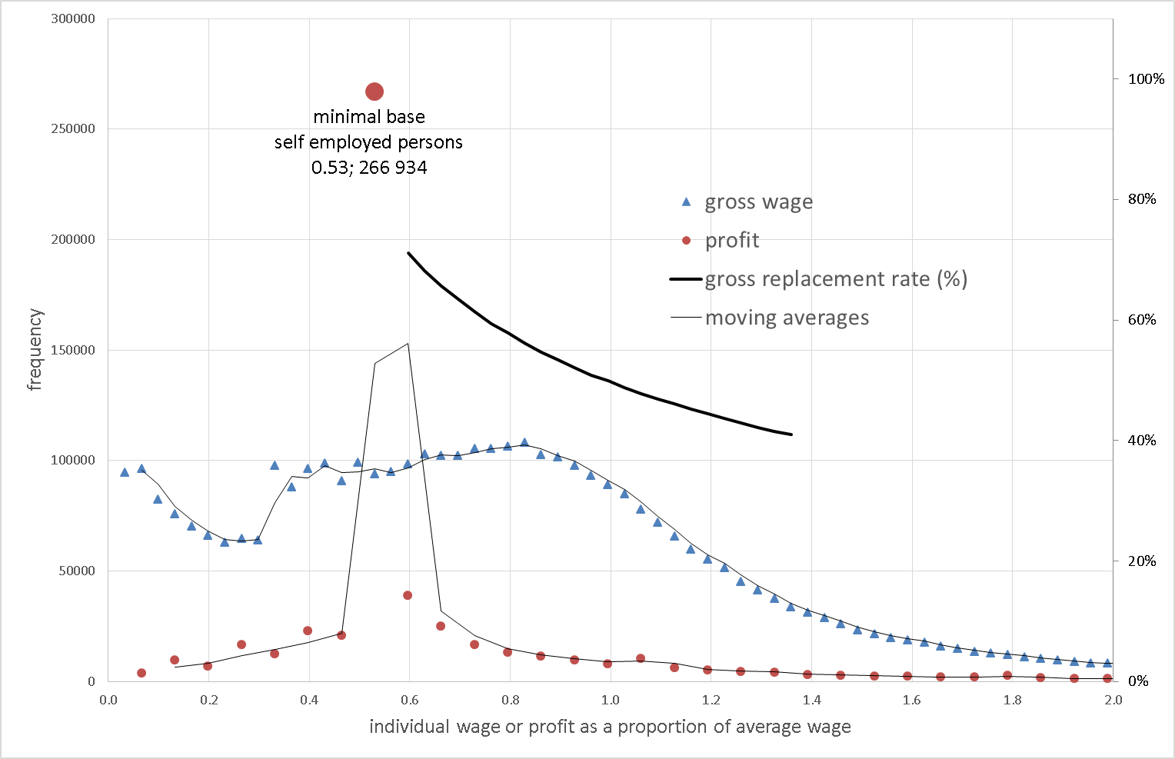
Results – overview of profits and wages statistics
Intro
Data
Methods
Results
Discussion
References

Slide 23
Summary results for self-employed person
Intro
Data
Methods
Results
Discussion
References
Base // profit (minimum) | Absolute (relative) frequency | Monthly pension benefit | gross replacement rate | lifetime payments | lifetime benefits | benefit/payment ration
75 420 // 150 840 | 266 934 (48 %) | 7 831 (333 Euro) | 0,61 (1,21)^{X} | 739 116 | 1 373 580 | 1.86
Note: Payment rate is 28 % for the whole payment period (35 years). We suppose that the pensioner will be receiving the pension for 15 years. Gross RR = pension/profit
Gross RR^{X} = pension/(0.5profit)
X – benefits/only work-related earnings

Slide 24
Summary results for employee and distributions of income - table
Intro
Data
Methods
Results
Discussion
References

Slide 25
Another Evil in the system
Revenues | 100 | 100
Cost actual | 0,5 | 50
Cost blanked (flat tax expenditures) | 0,8 | 80
Actual living standards |  | 50
Reported living standars |  | 20
Benefis | 0,6 | 12
BEN/actulal |  | 0,24
BEN/reported |  | 0,6

Slide 26
Conclusions
Intro
Data
Methods
Results
Discussion
References
The analysis revealed, that the 50 % of self-employed persons face the gross replacement ration (RR) equals to 61 %, (or 121 % if the reduction of the profit by 50 % is taken into account - assessment base is a 50 % of profit), in comparison with the employees, who face the gross RR equals to 50 % for average wages and 56 % for median wages.
Completely different picture is revealed if we focus on the nominal measure (nominal pension for month or nominal pension on the lifetime basis). The nominal pensions for self-employed persons reporting the minimal base are CZK 7 831 with comparison of CZK 12 471 (11 702) for average (median) wages.

Slide 27
Learning process…
To know the nominal benefits
To compare them with payments (system is relatively good for self-employed persons, no reason for opt-out, they should stay there)
To compare them with living standard faced during the working/active period
And as a result…
To help to make better decision (to save more)

Slide 28
Short summary
The Czech self-employed persons live in the dangerous illusion. They are winners (relative benefits are huge), but still not enough to sustain the previous living standards.
And it must be admitted that a very problematic role plays also Czech legislation/setting of flat tax expenditure and setting of earning base for pension payments to the system.

Slide 29
Conclusions cont.
Intro
Data
Methods
Results
Discussion
References
Due to high level of progressivity of pension system in the Czech Republic the “poorer” group reaches the better relative measures (gross and net RRs).
Due to assumption, that capital income is not limited to the serviced period and is accessible also in the retirement period, the assessment base is reduced by law by 50 %. This reduction is the second reason of low level of nominal benefits for self-employed persons.
We believe that academic and political discussion of the reduction level of assessment base will initiate the changes of this level.
We also believe that easy accessible and correct information concerning the individual estimated future benefits (as for example in Sweden, Pensionsmyndigheten (2016)) can motivate the persons to increase the level of contribution (not only) to the public pension schemes.

Slide 30
Sweden – Decide for yourself When to Retire concept

Slide 31
KOOOONNNEEcc Conclusions cont. Asi smazat…
We can sum up that the income distribution of self-employed persons is highly concentrated, with the peak at the profit level which corresponds with the minimal base for pension contribution (tax evasions? Avoidance?).
This profit level is approx. 66 % of median wage and 50 % of average wage in 2012. Due to the high degree of the Czech pension system progressivity, the general result is that the self-employed persons are better off in comparisons with the employees if we concentrate on relative measures, but worst off if we concentrate on nominal measures. The nominal pension for self-employed persons reporting the minimal base is CZK 7 631 with comparison of CZK 12 471 (11 702) for average (median) wage.

Slide 32
Second devil – blanked costs 80 % flat-rate expenditure
unrealistic exorbitant exaggerative
unrealistic unreasonable exaggerative
craftsman, farmer

